Slide 1



CoolMetrix: UHI Analysis and Mitigation Platform
Leveraging Remote Sensing and AI for Urban Heat Island Mitigation

Slide 2

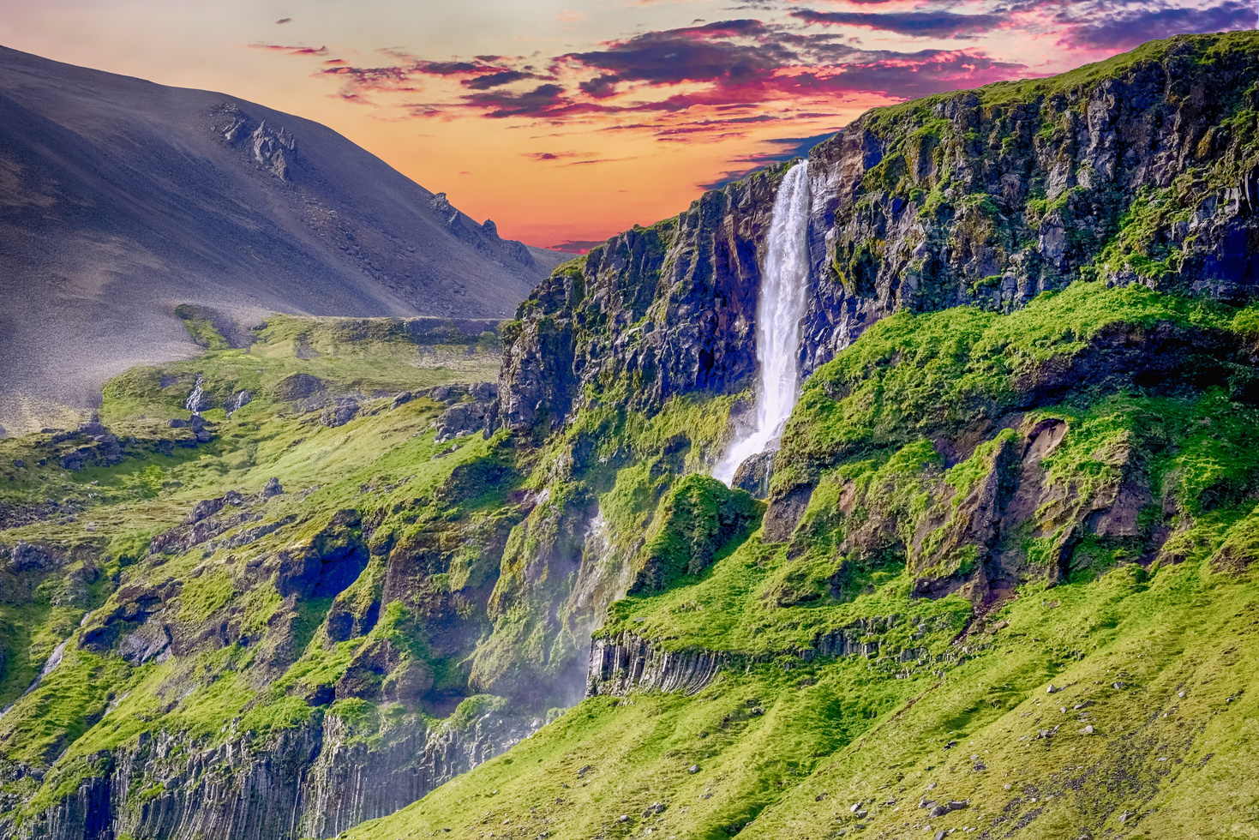
Our Project
Our project uses satellite data to measure urban heat, vegetation, and air quality. It helps identify how much hotter cities are than their surroundings. This information guides efforts to make cities greener and cooler. It supports more sustainable urban planning.

Slide 3


03
ENVIRONMENTAL IMPACT
Our project uses satellite data to analyze how urban areas contribute to higher local temperatures and affect surrounding ecosystems. It tracks heat patterns, vegetation health, and pollution levels, revealing the environmental impact of cities. By understanding these effects, it helps assess how urbanization alters natural climates and local environments.

Slide 4
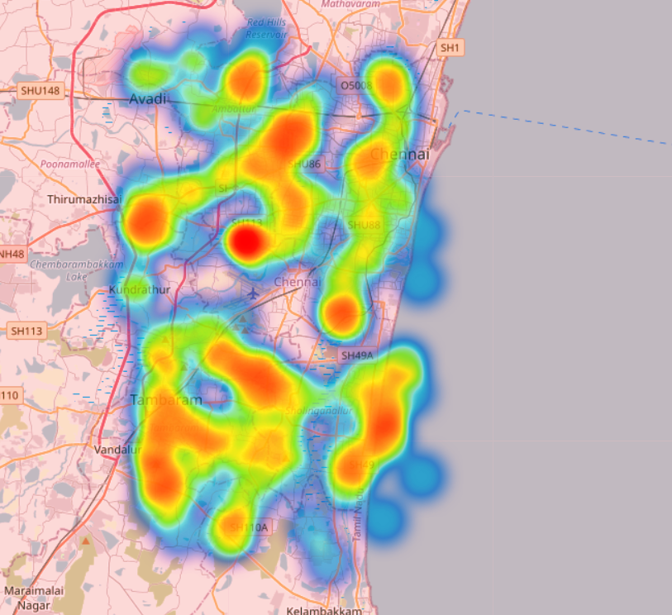
07
HEAT SPOTS
The K-Means clustering algorithm segments Urban Heat Island (UHI) data into five clusters based on UHI values, labeling each data point with a cluster number. Random latitude and longitude coordinates are assigned to each data point, which are then used to create a heat map using Folium. This map, saved as an HTML file, visually represents UHI intensity across Chennai, helping identify high-impact areas for targeted mitigation strategies.

Slide 5
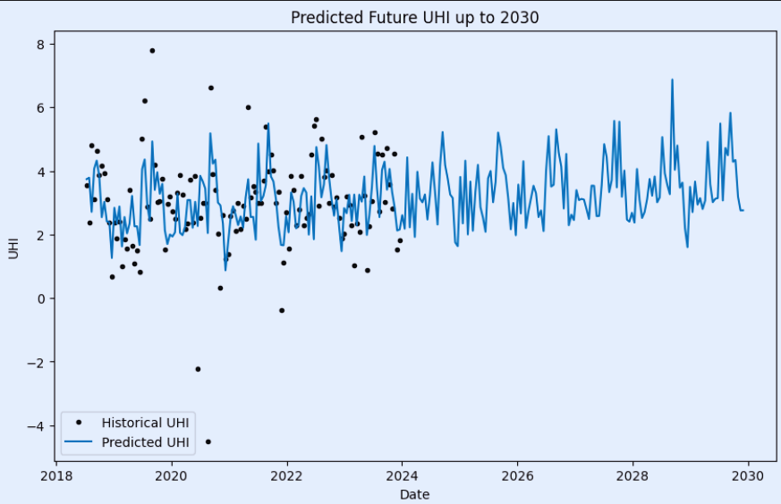
08
SUSTAINABLE CONSUMPTION
Our script processes UHI data by splitting it into training and testing sets, then trains Random Forest and XGBoost models to predict UHI values. It evaluates these models for accuracy. Using Prophet, it forecasts UHI trends up to 2030, considering seasonal patterns. Finally, it plots both historical and predicted UHI values to show future changes.
Our code trains Random Forest and XGBoost models on UHI data, yielding RMSE values of approximately 1.12 and 1.05, respectively, and R² scores of 0.87 and 0.89, and uses Prophet to forecast UHI trends up to 2030, visualizing historical UHI and future predictions.

Slide 6
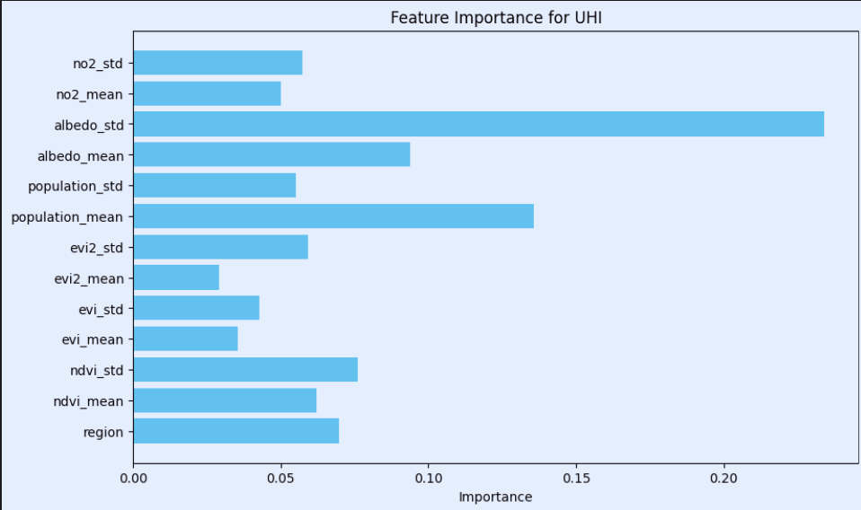
07
FEATURE IMPORTANCE
Our code trains a Random Forest model to predict Urban Heat Island (UHI) intensity using a dataset. After training the model with 100 trees, it calculates the importance of each feature in predicting UHI. The results are then visualized in a horizontal bar chart, where each feature is plotted against its calculated importance score. The chart helps to identify which features most significantly influence UHI predictions, providing insights into the key factors driving temperature variations in urban areas.

Slide 7
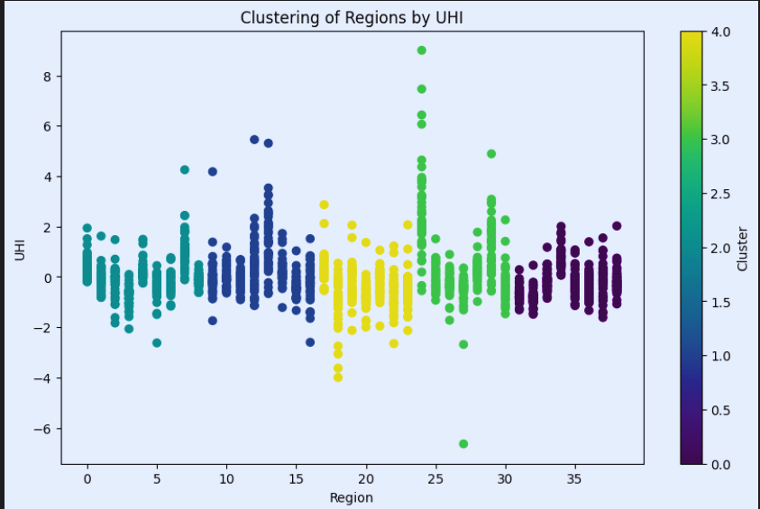
07
CLUSTERING ANALYSIS
Our project performs clustering on the dataset using K-Means with 5 clusters. It assigns each data point to a cluster based on its Urban Heat Island (UHI) intensity. The results are visualized in a scatter plot, where each region is plotted against its UHI intensity. The colors in the plot represent different clusters, helping to identify patterns and groupings among regions based on their UHI values. The colorbar indicates which cluster each color corresponds to.

Slide 8
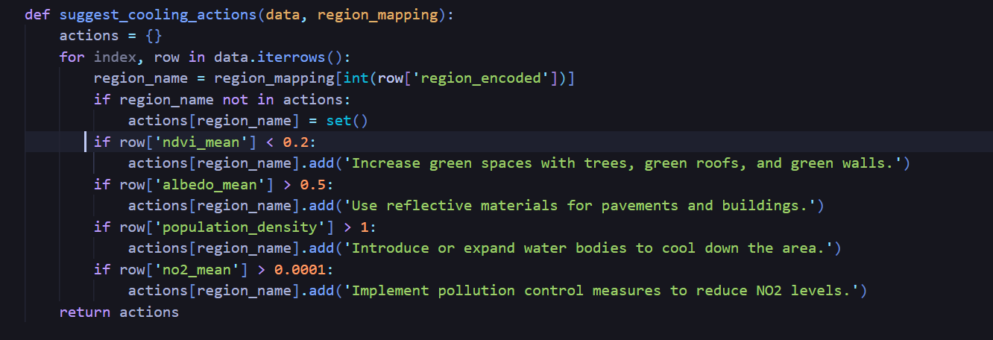
07
COOLING SUGGESTIONS
Lakshmipuram, Madhavaram Milk Colony, Manali New Town, Manjambakkam, Mathur MMDA, Medavakkam, Minjur, Mudichur, Naravarikuppam, Pallikaranai, Pappakurichi Kattupakkam, Pattabiram, Perungudi, Puzhal, Sembakkam, Sholinganallur, Tambaram, Thirumullaivoyal, Thiruninravur, Thiruverkadu, Tirusulam exceed the threshold of Mean NDVI, Mean Albedo, Population Density, Mean NO2 so the cooling actions suggestions are: Implement pollution control measures to reduce NO2 levels., Increase green spaces with trees, green roofs, and green walls. Introduce or expand water bodies to cool down the area.
We have compared Mean NDVI, Mean Albedo, Population Density, Mean NO2 to suggest colling actions to different regions of Chennai.
We have analysed that Adyar, Annanur, Avadi, Ayappakkam, Gerugambakkam, Guindy, Irumbuliyur, Iyyapanthangal, Kadaperi, Kallikuppam, Kathirvedu, Kodungaiyur, Kundrathur,

Slide 9

08
MITIGATION
Techniques
This project is designed to analyze and mitigate the environmental impact of Urban Heat Islands (UHIs). It starts by processing historical UHI data to identify patterns and correlations. Key features are selected and used to train a Random Forest model to predict UHI levels. The code also forecasts future UHI trends with a SARIMA model and suggests cooling strategies based on feature importance, such as increasing green spaces or improving air quality. Finally, it monitors the effectiveness of these strategies by tracking UHI trends over time. This approach helps in understanding and reducing the heat island effect, leading to cooler and more sustainable urban environments.

Slide 10

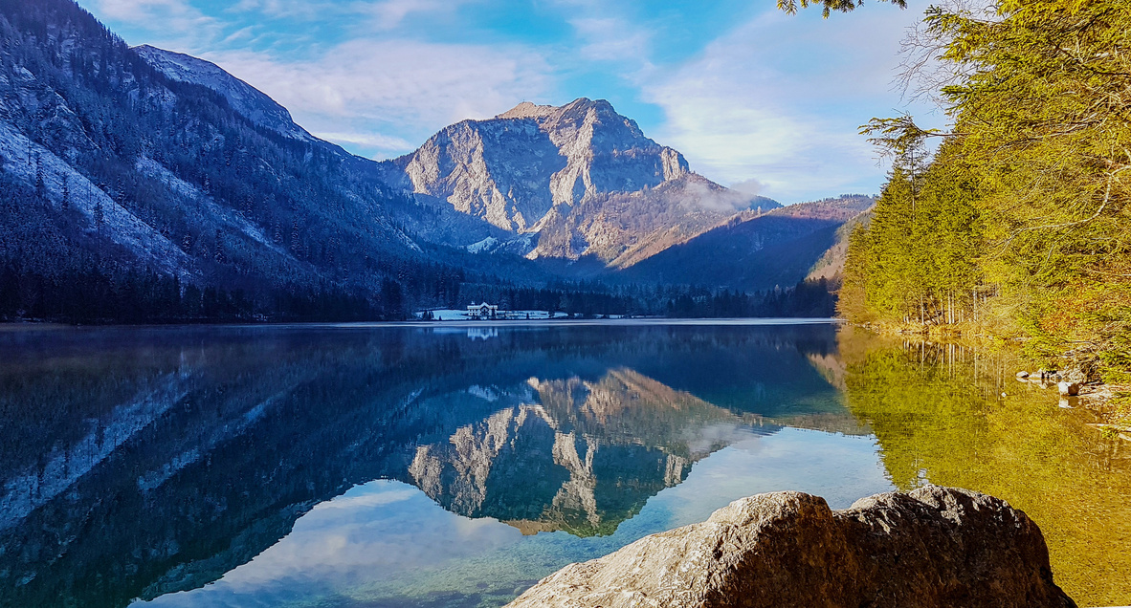
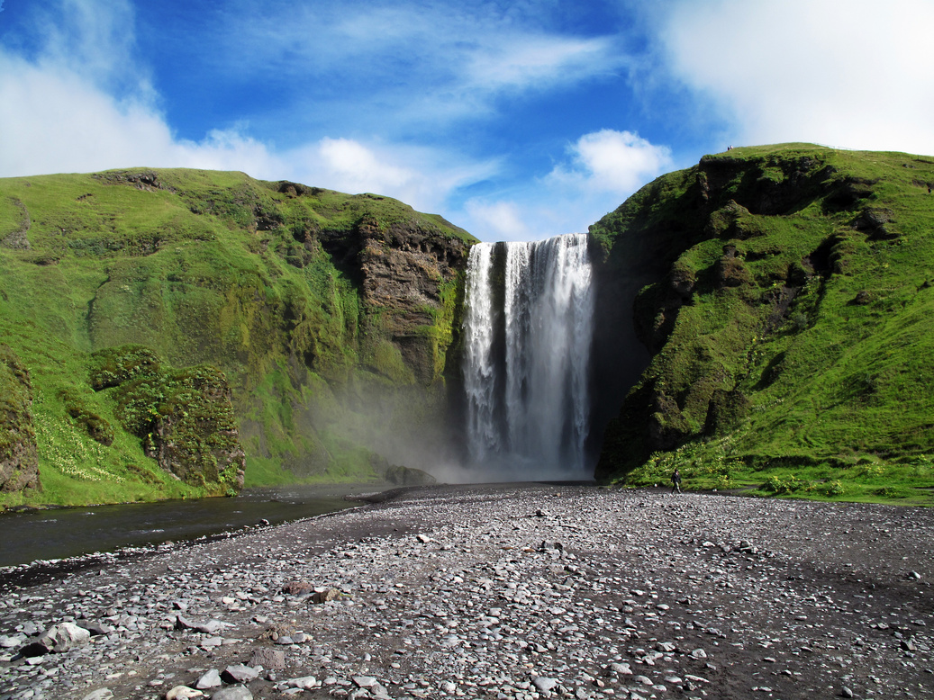
Team TensorTrove
Members -
Debjit Mandal
Anubhav Mazumder
Nilotpal Basu
Ankit Dey

Slide 11

Thank You

